Slide 1
Albanian Qualifications Framework referencing to the European Qualifications Framework and self-certification of compatibility with self-referencing to the Qualifications Framework of the European Higher Education Area
Albanian Qualifications Framework
By Prof. Aleksander Xhuvani
May 19th, 2022

Slide 2
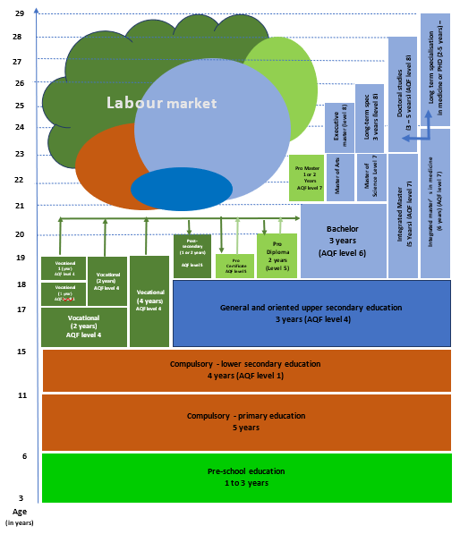
Thematic discussion
on Qualifications Framework
Albanian Educational Map
EDUCATIONAL MAP LEGEND:
Pro Certificate - Professional post-secondary Certificate
Pro Diploma - Professional post-secondary Diploma
Pre-primary educational system: 2121 institutions, 11.4 % are private , 88.6 % are public;
Primary education: 463 institutions, 100% public
Lower secondary 1228 institutions, 10% are private, 90% are public;
General and oriented secondary education, 453 institutions, 24 % are private, 76% are public;
Vocational Education, 45 institutions, 35 public providers and 10 private ones
Higher education: 41 Institutions, 26 are private, are 15 public
March 15th, 2022

Slide 3
Thematic discussion
on Qualifications Framework
Phases the AQF went through
2006
The AQF process started with the support of EU CARDS AFP 3 in the area of the Bologna Process in HE and VET and first AQF task Force is established by both Ministers of Education and Labour.;
AQF Task Force in cooperation with EU CARDS AFP 3 project proposed the first AQF Law approved by the Parliament in 2010, describing the main features of the AQF
The NESS 2014-2020 Action plan foresaw a review and implementation of the AQF law, in order to further develop and implement AQF.
The new joint ministerial Task Force with representatives of social partners, VET providers and HEI was established with the mandate to further develop and implement an operational AQF and support referencing process.
AQF task force proposed the amendment of the AQF law of 2010, which has been approved in 2018 by Albanian Parliament;
The AQF Task Force created the Technical Group of Experts in view of detailing the AQF level descriptors, establishing the sectorial committees and defining criteria and procedures for inclusion of LLL qualifications in AQF
NESS is extended till 2022, makes several references to the AQF priority development aspects like the endorsement of national catalogue for vocational qualifications, establishing first sectorial committees… etc
By legal acts on AQF level descriptors establishing the sectorial committees and defining criteria and procedures for inclusion of LLL qualifications in AQF, adopted
National catalogue for vocational qualifications in VET adopted and joint ministerial order to establish the sectorial committee in ICT adopted.
Referencing with EQF and QF EHEA
2010
2014
2015
2017
2018
2019
2021
2021
March 15th, 2022

Slide 4
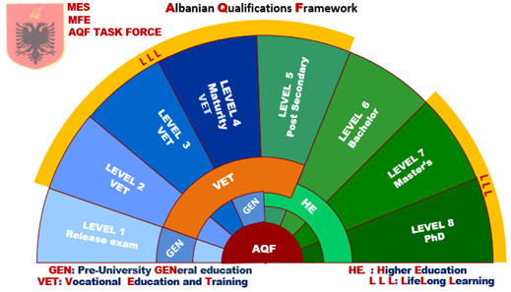
Thematic discussion
on Qualifications Framework
AQF Organigramme
LEVEL 1 First level Pre-university (general): compulsory education
LEVEL 2 Second VET level: Professional Certificate issued at the conclusion of the two-year program for semi-skilled workers;
LEVEL 3 Third VET level:
-Professional certificate issued at the end of a one-year program for skilled workers;
-Professional certificate issued at the end of a three-years program for skilled workers;
-Professional Certificate issued upon completion of an apprenticeship programme;
LEVEL 4 Fourth VET level:
-State Professional Matura Diploma issued upon completion of the vocational high school programme;
-Professional Certificate issued at the conclusion of the four-year study program for middle technicians / managers;
-Professional certificate issued at the conclusion of the one-year program for middle technicians /managers;
-Professional Certificate issued at the conclusion of the two-year program for middle technicians’ / managers;
-Professional Certificate issued at the end of an apprenticeship programme.
Fourth Pre-university general level:
-State Matura Diploma issued upon completion of the high school programme;
At the time being:
GENERAL PRE-UNIVERSITY EDUCATION , HIGHER EDUCATION AND LLL
under the responsibility of the Ministry of Education end Sports (MES)
VOCATIONAL EDUCATION AND TRAINING and LLL
under the responsibility of Ministry of Finance and Economy (MFE)
MES and MFE → AQF Task Force
March 15th, 2022

Slide 5
Thematic discussion
on Qualifications Framework
AQF Diagram
LEVEL 5 Fifth level post-secondary in VET: Professional certificate non-university study program after secondary education
Short Cycle in HE:
Professional Certificate (1year - 60 ECTS) Professional Diploma (2 years – 120 ECTS)
LEVEL 6 First HE level: Bachelor Diploma (at least 3 years – at least 180 ECTS)
LEVEL 7 Second HE level
Professional Master - (1 year - 60 ECTS)
Professional Master (2 years -120 ECTS
Master of Sciences or Master of Arts (2 years – 120 ECTS)
Integrated Master (5-6 years – 300-360ECTS)
LEVEL 8 Third HE level
Executive Master (1 year - 60 ECTS)
Executive Master (2 years - 120 ECTS)
2 years (Long-term specializations (at least 2 years – at least 120 ECTS)
(Doctoral Degree – (3 years up to 5 years)
LEVELS 2-5, 7-8 Lifelong learning qualifications
AQF legal framework :
the law no. 23/2018 after the first law of 2010;
DCM no. 426, of 26.6.2019 “Organization, functioning and criteria selection for the members of sectoral committees and their reward”;
DCM no. 427, of 26.6.2019 “The approval of criteria and inclusion procedures for long-life learning qualifications, according to the Albanian qualifications framework levels for education and professional training”
DCM no. 428, of 26.6.2019 “The approval of table detailed descriptions of the Albanian qualifications framework levels”
March 15th, 2022

Slide 6
Thematic discussion
on Qualifications Framework
Governance structure
Governing institutions
Advisory bodies
Implementation institutions
Ministry of Education and Sports
(MES)
Council for Higher Education and Science (CHES)
Agency for Quality Assurance in Higher Education (AQAHE)
Agency for Quality Assurance in Pre-university Education (AQAPE), General Directorate for Pre-university Education, RED
Albanian Qualifications Framework Task Force
Ministry of Finance and Economy
(MFE)
Centre of Education Services (CES)
National VET Council
National Agency of Vocational Education and Training and Qualifications (NAVETQ)
National Agency for Employment and Skills
Up to 10 Sectorial Committees
March 15th, 2022

Slide 7
Thematic discussion
on Qualifications Framework
EQF to AQF
EQF versus AQF
EQF levels | AQF Levels
LEVEL 1 | No equivalency in the AQF
LEVEL 2 | LEVEL 1
LEVEL 2 | LEVEL 2
LEVEL 3 | LEVEL 3
LEVEL 4 | LEVEL 4
LEVEL 5 | LEVEL 5
LEVEL 6 | LEVEL 6
LEVEL 7 | LEVEL 7
LEVEL 8 | LEVEL 8
Following the Albanian legal framework there is no any qualification awarded corresponding to the EQF first level
March 15th, 2022

Slide 8
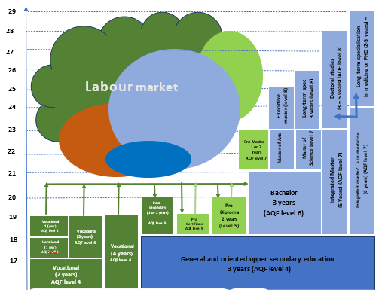
Thematic discussion
on Qualifications Framework
Albanian HE Educational Map
From post-secondary vocational training there is no any direct bridge to HE system (only via maturity exam)
From post-secondary HE qualification there is a conditional direct bridge to the Bachelor or Integrated Master studies
Lower secondary education
One can observe the decreasing number of students within the last years due to:
demographic evolution;
brain drain.
March 15th, 2022

Slide 9
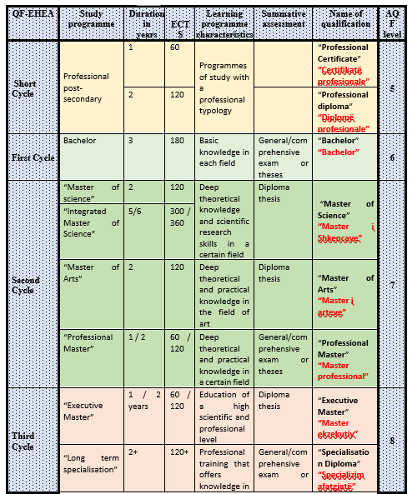
Thematic discussion
on Qualifications Framework
Albanian HE Educational Map
Lower secondary education
HE system is led by the law 85/2015 (after 2007 and 2010 laws)
March 15th, 2022

Slide 10
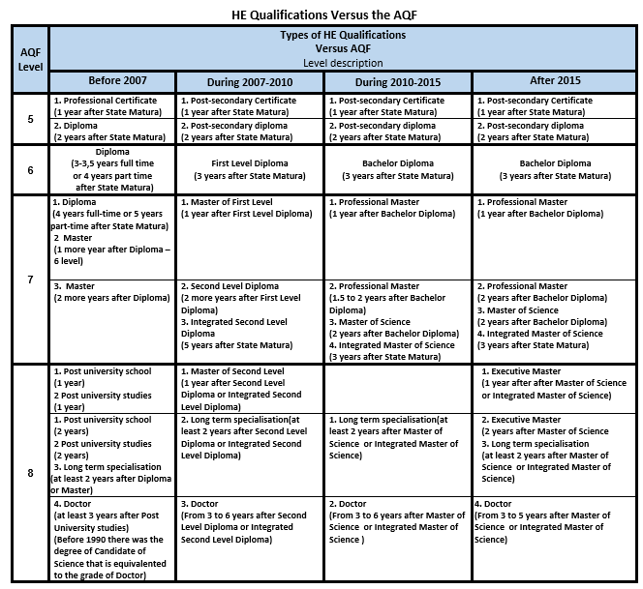
Thematic discussion
on Qualifications Framework
Albanian HE Qualification QA
March 15th, 2022

Slide 11
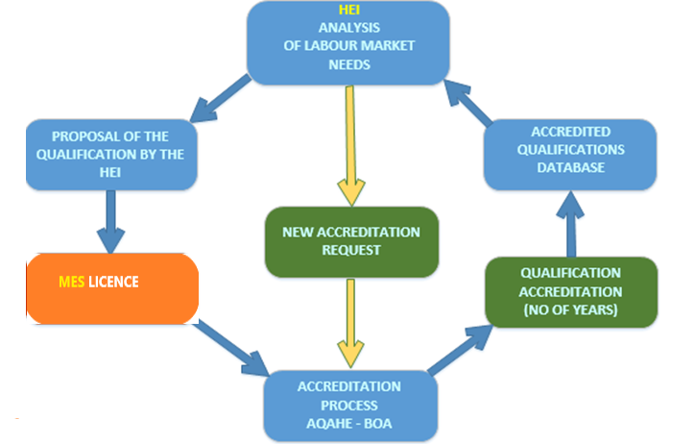
Thematic discussion
on Qualifications Framework
Albanian HE Qualification QA
A loop scheme in the respect of HEI autonomy with three check-points:
Licencing process led by the MES
Student matriculation led by the CES
Accreditation process led by the AQAHE
Lower secondary education
The AL HE system is governed by the HE Law no.85/2015, entirely Bologna Process oriented
March 15th, 2022

Slide 12
Thematic discussion
on Qualifications Framework
Albanian referencing report
Level descriptor's philosophy
COMPETENCES
KNOWLEDGE
Competences in terms of autonomy & responsibility
Statements on complexity of general and vocational knowledge necessary for performing a set of jobs or further learning
SKILLS
Cognitive, psychomotor and/or social skills, differentiation of which is determined by the nature of the set of jobs, complexity of problem, type of communication, handling resources and materials
March 15th, 2022

Slide 13
Bologna Thematic Peer Group A
on Qualifications Framework
Albanian referencing report
AQF Level 6 descriptors
AQF level | Knowledge | Skills | Responsibility and autonomy
6 | Bachelor
 | knowledge and critical understanding of the well-established principles of their areas of study, and of the way in which those principles have developed; ability to apply underlying concepts and principles outside the context in which they were first studied, including, where appropriate, the application of those principles in an employment context; knowledge of the main methods of enquiry in their subjects, and ability to evaluate critically the appropriateness of different approaches to solving problems in the field of study; an understanding of the limits of their knowledge, and how this influences analyses and interpretation based on that knowledge. | qualities and transferable skills necessary for employment requiring the exercise of personal responsibility and decision-making; | use a range of established techniques to initiate and undertake critical analysis of information, and to propose solutions to problems arising from that analysis; effectively communicate information, arguments, and analysis, in a variety of forms to specialist and non-specialist environment audiences, and deploy key techniques of the discipline effectively; undertake further training, develop existing skills and acquire new competences that will enable them to assume significant responsibility within organisations.
March 15th, 2022

Slide 14
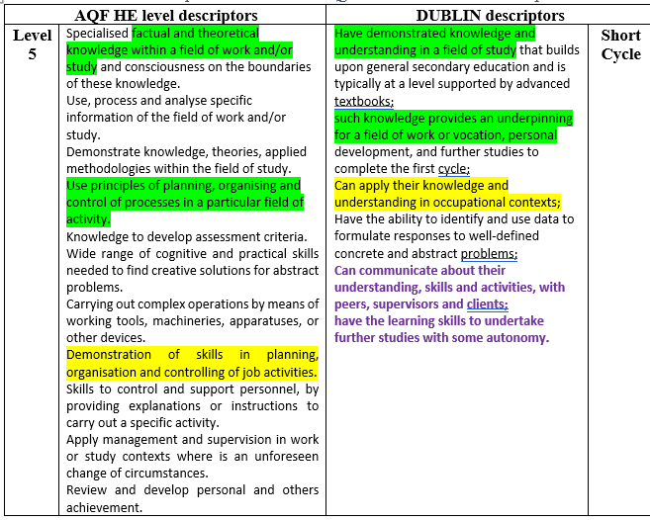
Thematic discussion
on Qualifications Framework
Albanian referencing report
AQF Level 5 descriptors to Dublin ones
March 15th, 2022

Slide 15
Thematic discussion
on Qualifications Framework
Albanian referencing report structure
GENERAL INTRODUCTION
1 - DESCRIPTION OF THE EDUCATION SYSTEM IN ALBANIA
2 - EUROPEAN BACKGROUND
3 - ALBANIAN QUALIFICATIONS FRAMEWORK
4 - REFERENCING AND SELF-CERTIFICATION OF THE AQF TO THE EQF AND QF-EHEA
5 - FULFILMENT OF CRITERIA AND PROCEDURES
6 - FURTHER DEVELOPMENT OF THE AQF
REFERENCES
APPENDIX
March 15th, 2022

Slide 16
Bologna Thematic Peer Group A
on Qualifications Framework
Albanian referencing report
5 - FULFILMENT OF REFERENCING CRITERIA AND PROCEDURES
- Referencing criteria of the AQF versus the EQF 10 CRITERIA
- Self-Certification of the AQF versus the QF-EHEA 7 CRITERIA
AQF Level | HE Albanian Qualifications definition | HE European Qualifications definition | EQF Level
5 | Post-secondary Certificate (60 ECTS) Diploma (120 ECTS) | Post-secondary HE degree Short cycles | 5
6 | Bachelor degree (180 ECTS) | Bachelor degree First HE cycle | 6
7 | Master degrees Professional (60 ECTS); Professional (120 ECTS); of Science (120 ECTS) | Master degree Second HE cycle | 7
8 | Executive Master (60 ECTS); Executive Master (120 ECTS); Doctoral studies | Doctoral studies Third HE cycle | 8
Response to the QF-EHEA Criteria and Procedures
In Albania, the competent national bodies certify the compatibility of the AQF with the QF‐EHEA ;
MES has been the co-initiator and co-coordinator (together with the MFE) in all phases in the development and implementation of the AQF;
The self-certification process have involved both local stakeholders international experts;
The completion of the self-certification process shall be noted on Diploma Supplements issued subsequently by showing the link between the AQF and the European frameworks;
Succeeding the process of AQF referencing is also due to the group of experts involved “enough big and small to be efficient”, “nationally and internationally” and to the hardworking & accuracy by implying a triple check to each national particularity.
Comparison between AQF descriptors and Dublin’s
March 15th, 2022

Slide 17
REFERENCING PROCESS AND ALBANIAN HEIs

Slide 18
Albanian HEI
Input
Output
MODEL - REFERENCING
Result 1
Labour market
Output : qualification
Result 2
HEI

Slide 19
Albanian HEI
Input : qualification
Diploma with its title
Output : qualification
Learning outcomes
Knowledge
Skills
Competence
A&R

Slide 20
Albanian HEI
Referencing : 2 processes
Come to any HEI
Go out any HEI
Letters of credence

Slide 21
Albanian HEI
Qualification
Letters of credence
Quant
Diploma
Education Title
DS
Qual

Slide 22
Albanian HEI
Education Title
Study Program
Courses
(modules)

Slide 23
Albanian HEI
Set of courses, composed in groups:
methodological preparation and general culture
preparation for scientific discipline
subdisciplines, profiles and elective subject groups
foreign languages, computer knowledge, professional practice
closing obligations
Expressed in ECTS points
Presented in the DS with LO
Study Program
Bachelor in any
area

Slide 24
Albanian HEI
AQF LEVEL
Study
Course
KNOWLEDGE
SKILLS
COMPETENCE (A&R)
Definition:
Database Design

Slide 25
Albanian HEI
Bachelor degree – level 6 of AQF;
6 ECTS points
One semester
AQF LEVEL

Slide 26
Albanian HEI
1. relational and object-oriented database models;
2. data processing models;
3. models of data control.
KNOWLEDGE

Slide 27
Albanian HEI
1. conceive of a relational database;
2. conceive the forms for filling the database;
3. conceive standard queries;
4. conceive the specific interface with the database.
SKILLS

Slide 28
Albanian HEI
implement an application in a database management system, alone or in a team.
COMPETENCE (A&R)

Slide 29
Albanian HEI
AQF LEVEL
Diploma
Supplement
KNOWLEDGE
SKILLS
COMPETENCE (A&R)

Slide 30
Albanian HEI
Level 6 according to AQF;
180 ECTS points
Three years
AQF LEVEL

Slide 31
Albanian HEI
The study program of the first cycle in the field of computer engineering offers basic engineering knowledge not only of general sciences, but also of basic sciences of computer engineering, hardware and software as well as languages and techniques. of programming.
KNOWLEDGE

Slide 32
Albanian HEI
On the other hand, this program gives the graduate the opportunity to knead with critical thinking so that it looks not only at the design aspects of the software or computer system, but also those of their optimal dimensioning and management.
SKILLS

Slide 33
Albanian HEI
On the other hand, this study program gives the graduate the opportunity of
using data processing system architecture,
using operating systems,
designing and implementing databases,
developing distributed network protocols, architectures and network services, software engineering, Web technologies, graphic and multimedia applications,
organizing the security and protection of network traffic systems.
COMPTENCIES
A&R

Slide 34
Albanian HEI
Referencing : 2 processes
Come to any HEI
Go out ofany HEI
“Kingdom of quality”

Slide 35
Albanian HEI
“Kingdom of quality”
is guaranteed by our
3 mousquetaires
ARAMIS
personifying
knowledge
Porthos
personifying
Skills
Athos
personifying
Autonomy & Responsibility

Slide 36
Albanian HEI
From our “Kingdom of quality”
to the whole World of Work
D’Artagnan
personifying
our graduated fellows
making them reverence to…

Slide 37
From
Tirana University
THANK YOU !

